Slide 1
Operating System
Week 1 - introduction
Korawit Orkphol, D.Eng

Slide 2
Operating System
03603332 Operating System (First semester of 2022)
Credits : 3 (3 hrs. In class-0 hr in Labs-6 hrs self-study)
Prerequisites : 03603223 Computer Architecture and Organization
Course description : Concepts of operating systems. Processes and concurrency. Process management and scheduling. Input/output management. Memory management. File systems. Computer systems security.
Duration : 15 weeks
Location & date time : 17301 Mon. 16.30-19.30
MSTEAM code : tml9h8o (This team is the channel for communication between instruction and students, assignments, relevant files, and online meeting.
Scoring : in-class activities 10%, assignments 20%, project 20%, midterm exam 20%, final exam 20%, class attend 10%
Grading : A: > 80, B+ to - D: based on group of students, F : <40
Contact : 23617 or korawit@eng.src.ku.ac.th or facebook
Material: mostly based on Operating Systems: Three Easy Pieces (wisc.edu)
Notes:
แนวคิดของระบบปฏิบัติการ กระบวนการและภาวะพร้อมกัน การจัดการและการ
กำหนดลำดับกระบวนการ การจัดการรับเข้า/ส่งออก การจัดการหน่วยความจำ ระบบแฟ้ม
ความมั่นคงของระบบคอมพิวเตอร์

Slide 3
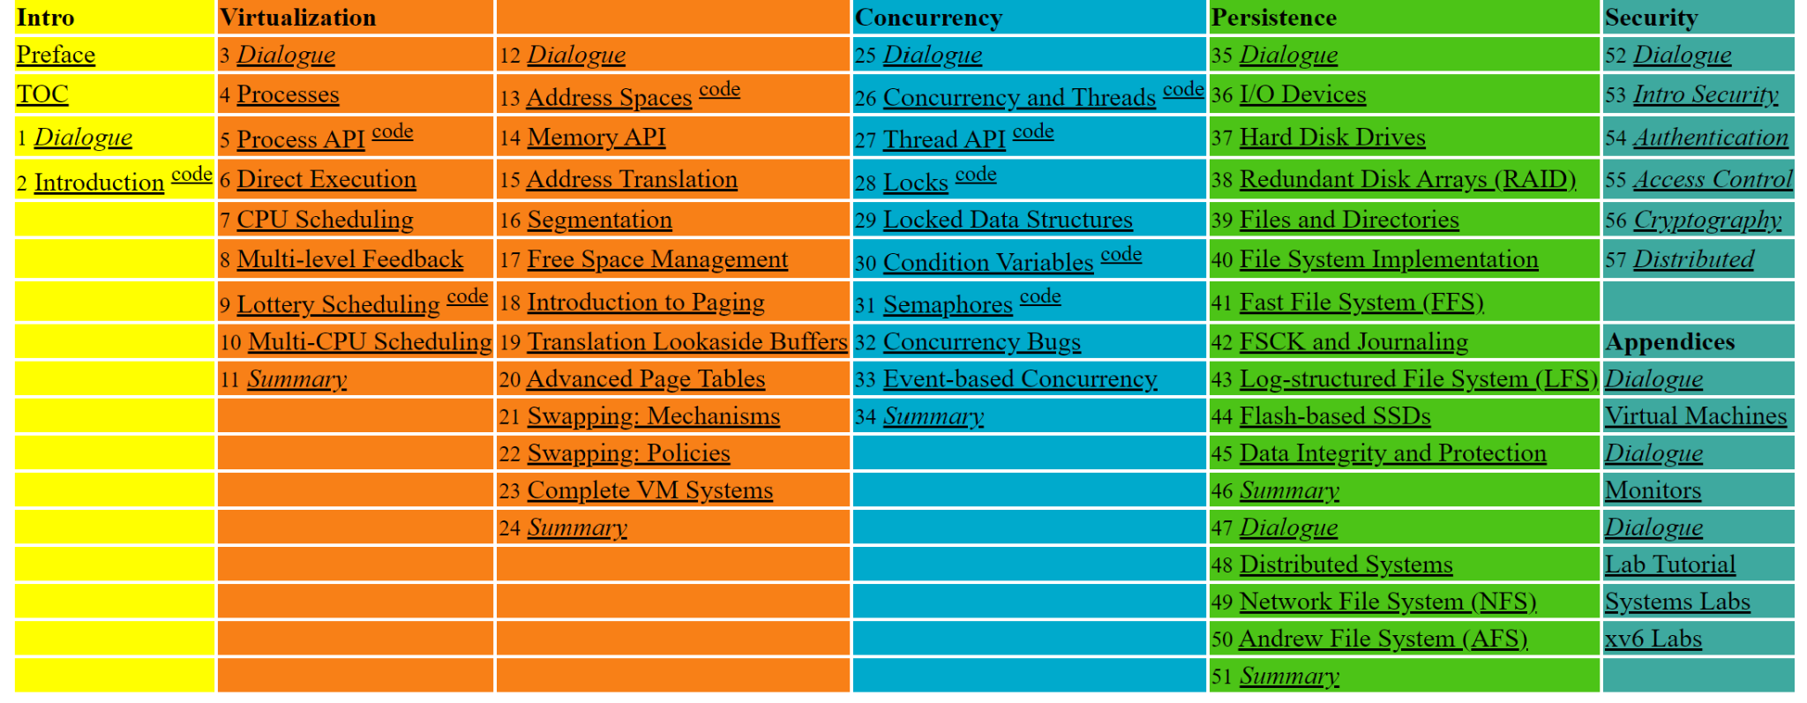
Content for 15 weeks (3 topics at a week)
Operating Systems: Three Easy Pieces (wisc.edu)

Slide 4

What OS do you know?
https://www.mentimeter.com/app/presentation/875b0f60af24de5c78dd812074fb8f54/bd75375ca296

Slide 5

What computer does when running a program?
Fetch
Processor fetches an instruction from memory
Decode
Figures it out which instruction this is
Von Neumann model of computing
After it is done with this instruction, the processor moves on to the next instruction, and so on and so on, until the program finally completes
Execute
It does the thing that supposed to do, adding 2 numbers, access memory,etc.
John von Neumann - Wikipedia

Slide 6
Primary goal of OS (1)
Sound Simple, right? But in this class we will be learning that while a program runs, a lot of other wild things are going on with the primary goal of making the system easy to use.
There is a body of software that responsible for making it easy to run programs (allowing you to seemingly run many at same time), allowing programs to share memory, enabling programs to interact with devices, and others.
The body of software is called operating system (OS), it is in charge of making sure that system operates correctly and efficiently in an easy-to-use manner.

Slide 7
Primary goal of OS (2)
OS does through a general technique called virtualization, OS takes a physical resource (processor, or memory, or a disk) and transforms it into a more general, powerful, and easy-to-use virtual form of itself. Thus we sometimes refer OS as a virtual machine.
In order to allow users to tell OS what to do and make use of the features of the virtual machine (running a program, or allocation memory, or accessing file), OS provides some interfaces (APIs) you can call. A few hundred system calls, are available to applications, we also sometimes called standard library to applications.

Slide 8
Primary goal of OS (3)
Finally because Virtualization allows
Many programs to run (CPU sharing)
Many programs to concurrently access their own instruction and data (memory sharing)
Many programs to access devices (disk sharing and so forth)
OS sometimes known as a resource manager. CPU, memory, disk is a resource of the system, OS’s role to manage those resources efficiently or fairly or indeed with many other possible goals in mind.

Slide 9
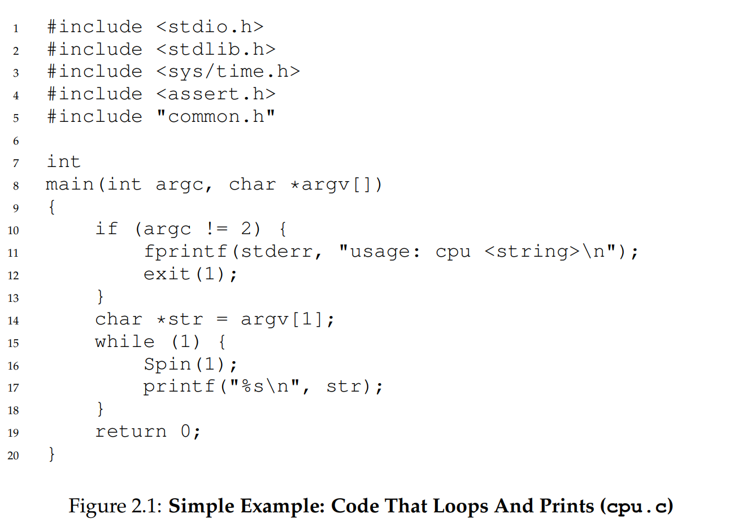
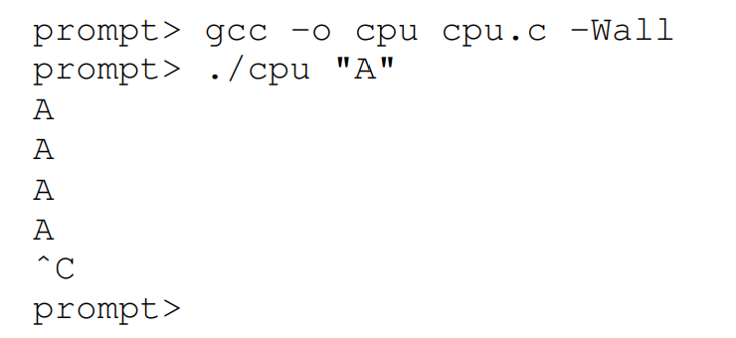
Virtualizing CPU (1)
spin(), a function that repeatedly checks the time and return once it has run for a second
ostep-code/intro at master · remzi-arpacidusseau/ostep-code · GitHub

Slide 10
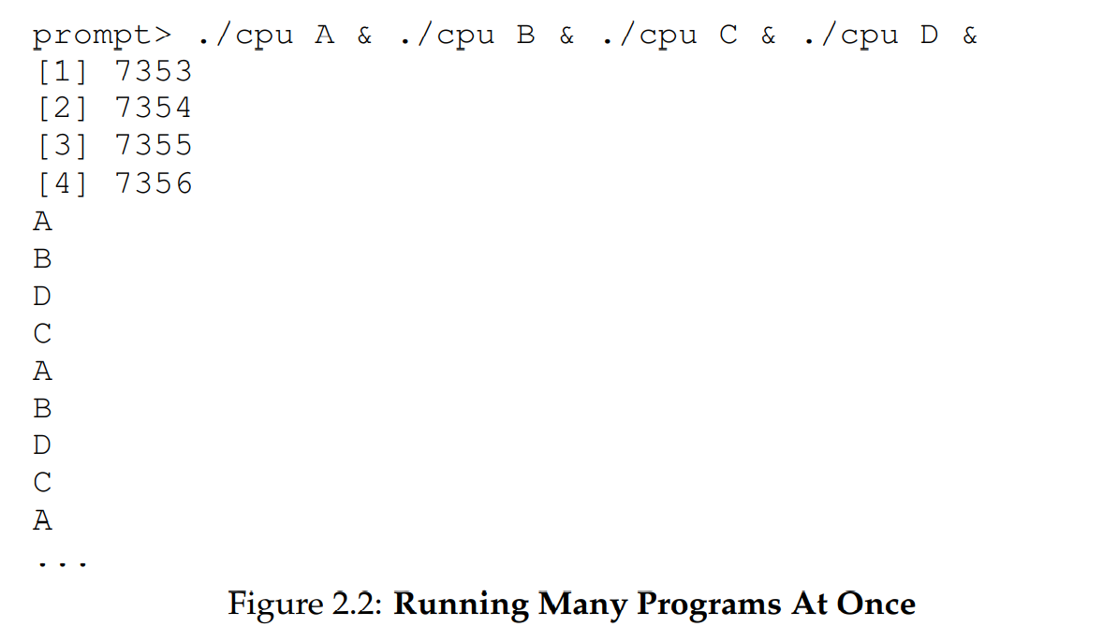
Virtualizing CPU (2)
Let’s run many different instances of this same program. Even though we have only one processor, somehow all four of these programs seem to be running at the same time! How does this magic happen?

Slide 11
Virtualization CPU (3)
In turns out that OS and some help from hardware, is in charge of this illusion, system has a very large number of virtual CPUs.
Turning a single CPU into a seemingly infinite number of CPUs and thus allowing many programs to seemingly run at once in what we call virtualizing the CPU, the focus of the first major part of this course.
Run programs, stop them, otherwise tell the OS which programs to run, there need some interfaces (APIs) that you can use to communicate your desires to OS.
You might notice the ability to run multiple programs at once raises all sorts of new questions.
If two programs want to run at a particular time, which should run? Policy of the OS
We will study them as we learn about the basic mechanisms that OS implement (a resource manager)

Slide 12
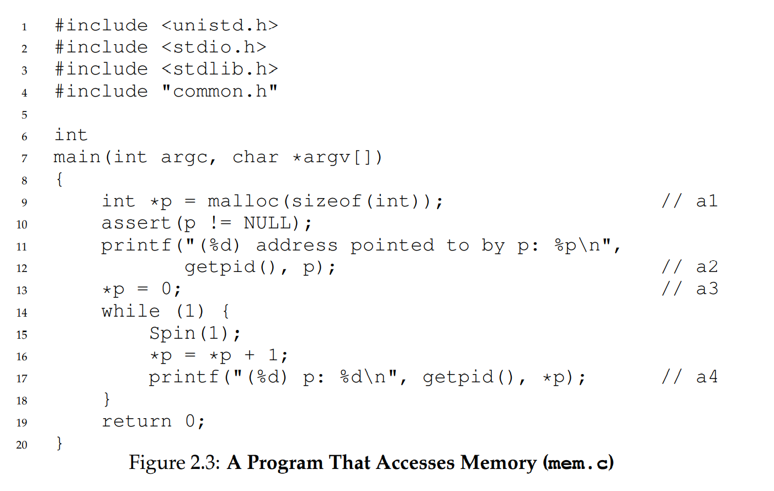
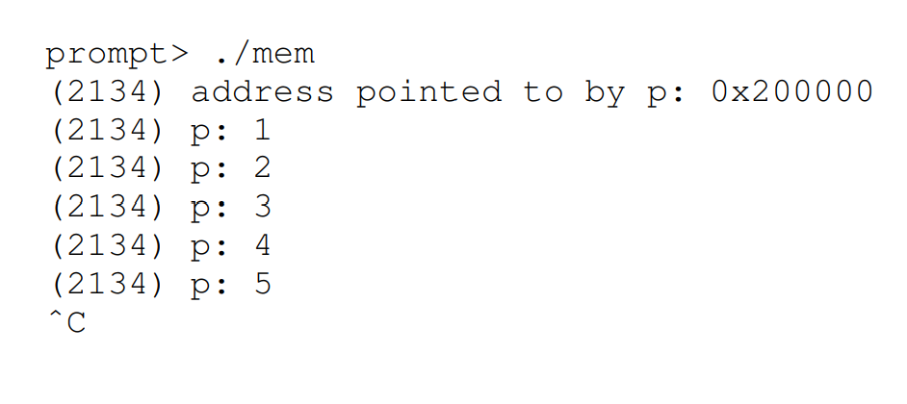
Virtualizing Memory (1)
Physical memory is just an array of bytes, to read memory, one must specify an address to access the data stored there, to write memory, one must also specify the data to be written to the given address. malloc() is a function to allocate memory.

Slide 13
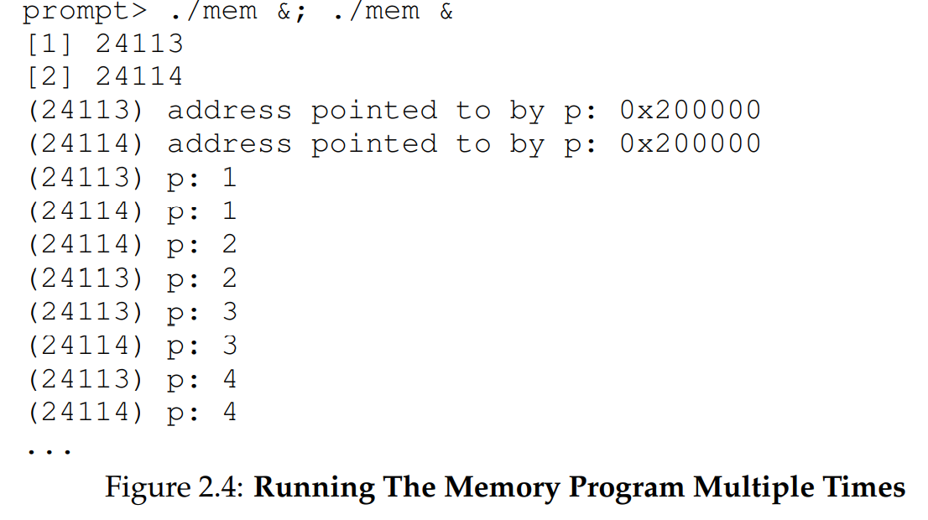
Virtualizing Memory (2)
The result shows that it allocated memory at the same address(0x200000) but each seems to be updating the value independently. Each running program has its own private memory, instead of sharing the same physical memory with other running programs. OS is virtualizing memory (Virtual address space) OS somehow maps onto the physical memory of the machine. Why ? who know, I have a reward for you.

Slide 14
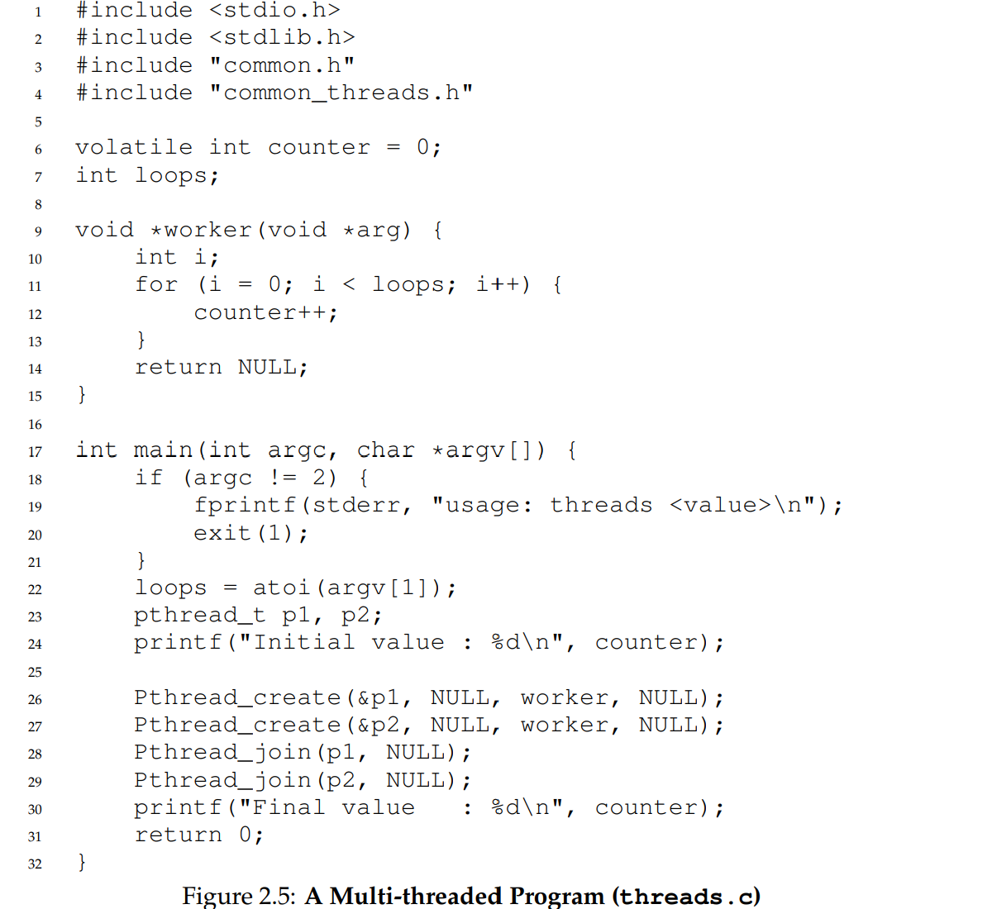
Concurrency(1)

Slide 15
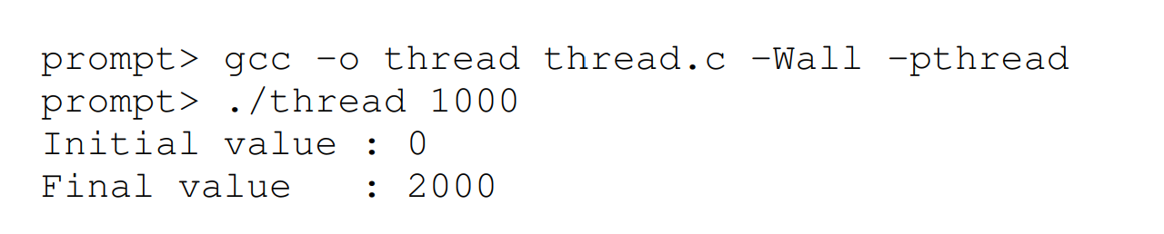
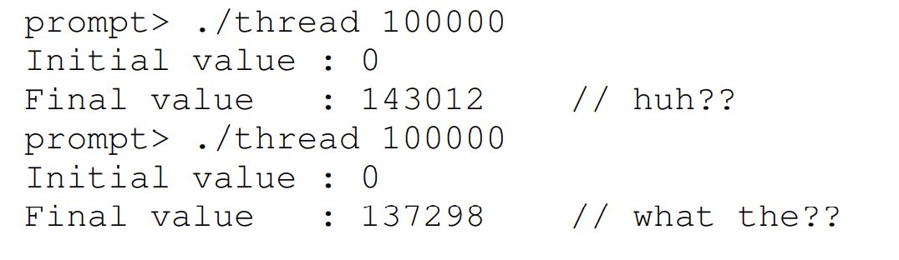
Concurrency(2)

Slide 16
Concurrency (3)
As it turns out, the reason for these odd and unusual outcomes relate to how instructions are executed, which is one at a time. Unfortunately, a key part of the program above, where the shared counter is incremented, takes three instructions:
one to load the value of the counter from memory into a register, one to increment it, and one to store it back into memory.
Because these three instructions do not execute atomically (all at once), strange things can happen. It is this problem of concurrency that we will address in great detail in the second part of this course

Slide 17
Persistence(1)
In system memory, data can be easily lost, as devices such as DRAM store values in a volatile manner; when power goes away or the system crashes, any data in memory is lost. Thus, we need hardware and software to be able to store data persistently; such storage is thus critical to any system as users care a great deal about their data.
The hardware comes in the form of some kind of input/output or I/O device; in modern systems, a hard drive is a common repository for long lived information, although solid-state drives (SSDs) are making headway in this arena as well.
The software in the operating system that usually manages the disk is called the file system; it is thus responsible for storing any files the user creates in a reliable and efficient manner on the disks of the system.

Slide 18
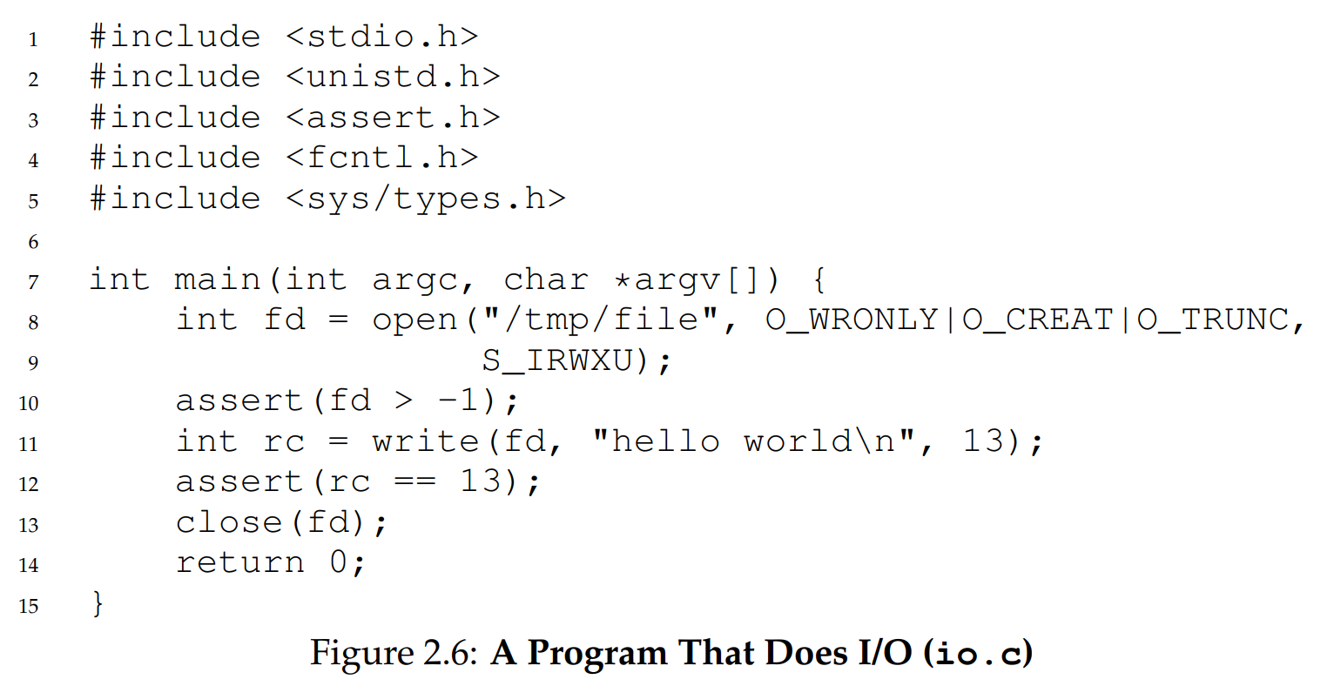
Persistence(2)

Slide 19
Persistence(3)
To understand this better, let’s look at some code. Figure 2.6 presents code to create a file (/tmp/file) that contains the string “hello world”.
To accomplish this task, the program makes three calls into the operating system.
The first, a call to open(), opens the file and creates it;
the second, write(), writes some data to the file;
the third, close(), simply closes the file thus indicating the program won’t be writing any more data to it.
These system calls are routed to the part of the operating system called the file system, which then handles the requests and returns some kind of error code to the user.

Slide 20
Persistence(4)
The file system has to do a fair bit of work: first figuring out where on disk this new data will reside, and then keeping track of it in various structures the file system maintains.
Doing so requires issuing I/O requests to the underlying storage device, to either read existing structures or update (write) them.
As anyone who has written a device driver knows, getting a device to do something on your behalf is an intricate and detailed process.
It requires a deep knowledge of the low-level device interface and its exact semantics. Fortunately, the OS provides a standard and simple way to access devices through its system calls. Thus, the OS is sometimes seen as a standard library.

Slide 21
Design Goal(1)
basic goals is to build up some abstractions in order to make the system convenient and easy to use.
Abstractions are fundamental to everything we do in computer science. Abstraction makes it possible to write a large program by dividing it into small and understandable pieces, to write such a program in a high-level language like C without thinking about assembly, to write code in assembly without thinking about logic gates, and to build a processor out of gates without thinking too much about transistors.
Abstraction is so fundamental that sometimes we forget its importance, but we won’t here; thus, in each section, we’ll discuss some of the major abstractions that have developed over time, giving you a way to think about pieces of the OS.

Slide 22
Design Goal(2)
One goal in designing and implementing an operating system is to provide high performance;
another way to say this is our goal is to minimize the overheads of the OS. Virtualization and making the system easy to use are well worth it, but not at any cost; thus, we must strive to provide virtualization and other OS features without excessive overhead.
These overheads arise in a number of forms: extra time (more instructions) and extra space (in memory or on disk).
We’ll seek solutions that minimize one or the other or both, if possible. Perfection, however, is not always attainable, something we will learn to notice and (where appropriate) tolerate.

Slide 23
Design Goal(3)
Another goal will be to provide protection between applications, as well as between the OS and applications.
Because we wish to allow many programs to run at the same time, we want to make sure that the malicious or accidental bad behavior of one does not harm others; we certainly don’t want an application to be able to harm the OS itself (as that would affect all programs running on the system).
Protection is at the heart of one of the main principles underlying an operating system, which is that of isolation; isolating processes from one another is the key to protection and thus underlies much of what an OS must do

Slide 24
Design Goal(4)
The operating system must also run non-stop; when it fails, all applications running on the system fail as well. Because of this dependence, operating systems often strive to provide a high degree of reliability.
As operating systems grow evermore complex (sometimes containing millions of lines of code), building a reliable operating system is quite a challenge — and indeed, much of the on-going research in the field

Slide 25
Design Goal(5)
Other goals make sense: energy-efficiency is important in our increasingly green world;
security (an extension of protection, really) against malicious applications is critical, especially in these highly-networked times; mobility is increasingly important as OSes are run on smaller and smaller devices.
Depending on how the system is used, the OS will have different goals and thus likely be implemented in at least slightly different ways. However, as we will see, many of the principles we will present on how to build an OS are useful on a range of different devices.

Slide 26

History of OS
One of the major practical advances of the time was the introduction of the UNIX operating system, primarily thanks to Ken Thompson (and Dennis Ritchie) at Bell Labs (yes, the phone company). UNIX took many good ideas from different operating systems (particularly from Multics, and some from systems like TENEX and the Berkeley TimeSharing System), but made them simpler and easier to use. Soon this team was shipping tapes containing UNIX source code to people around the world, many of whom then got involved and added to the system themselves

Slide 27

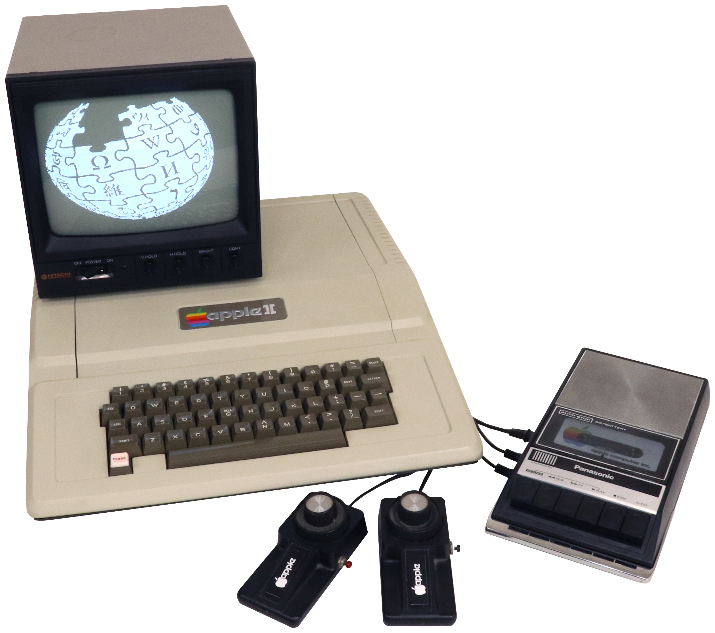
Modern Era

Slide 28
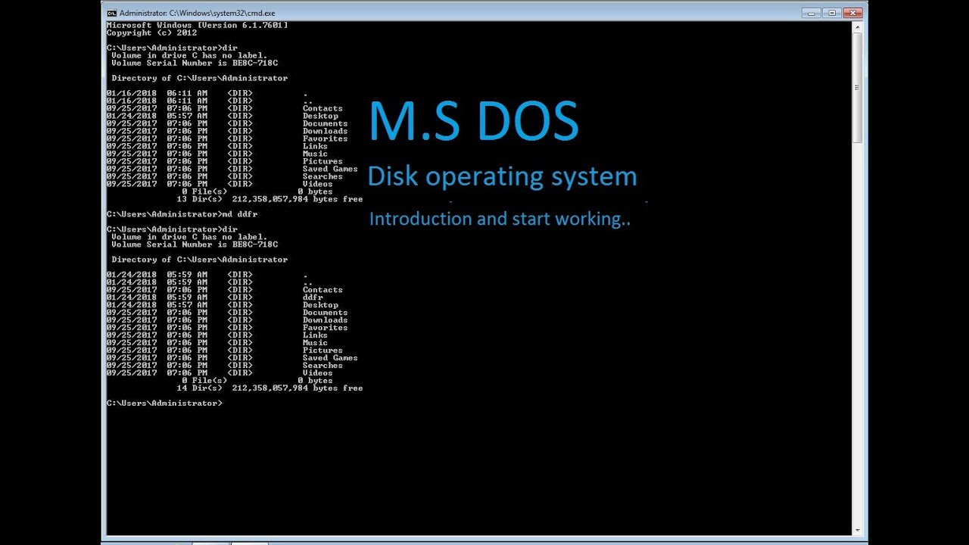
Microsoft DOS

Slide 29
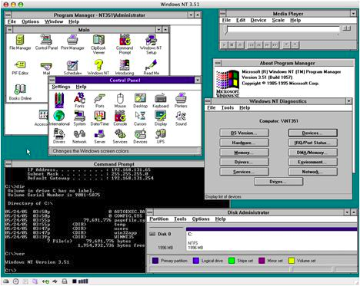
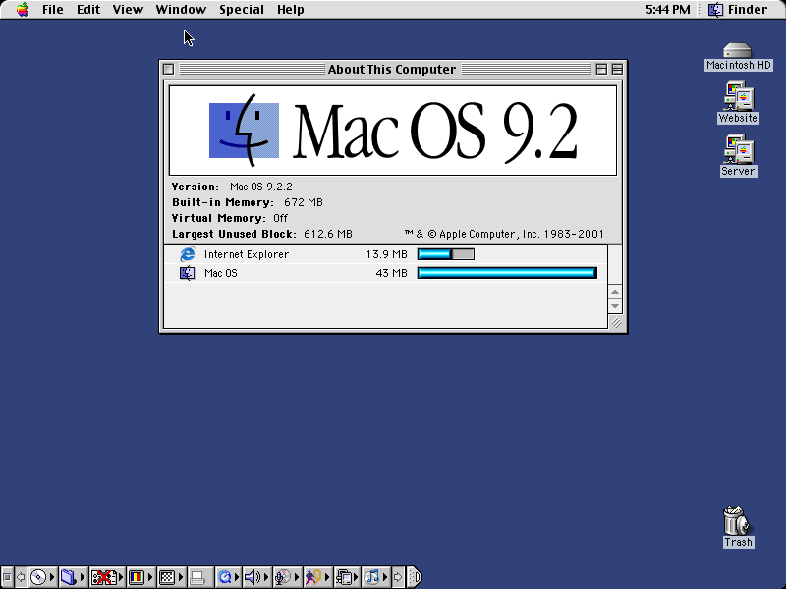
Windows NT & Mac OS 9.2

Slide 30
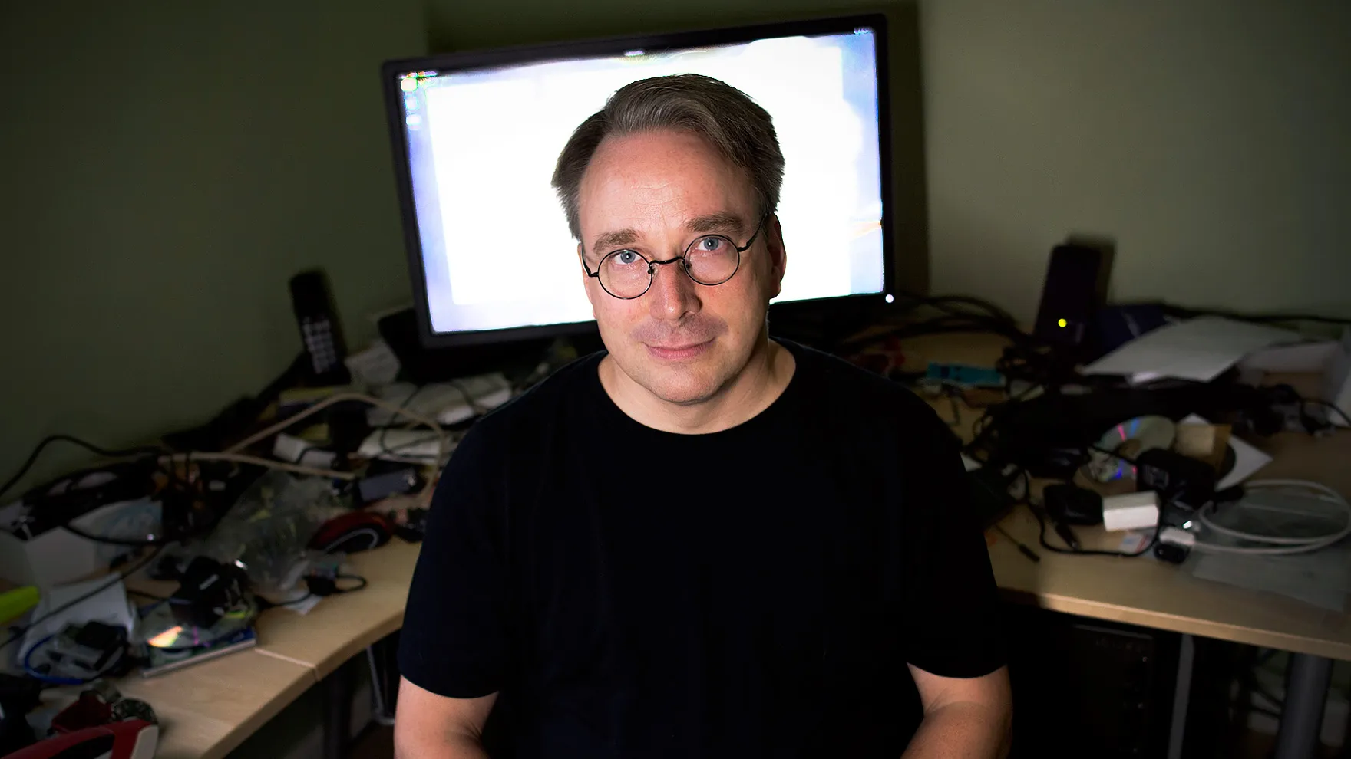
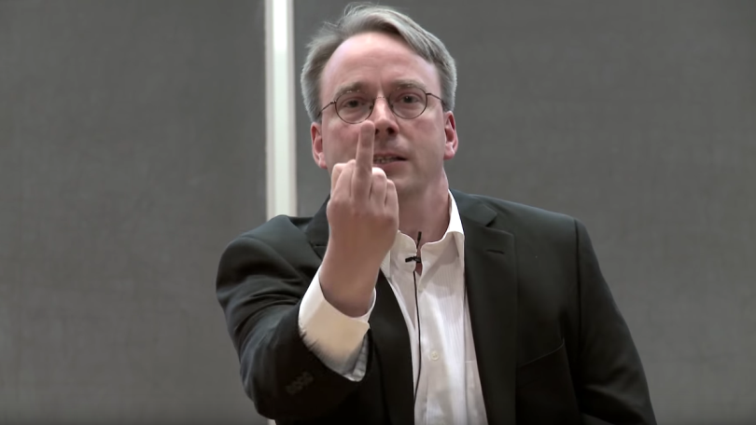
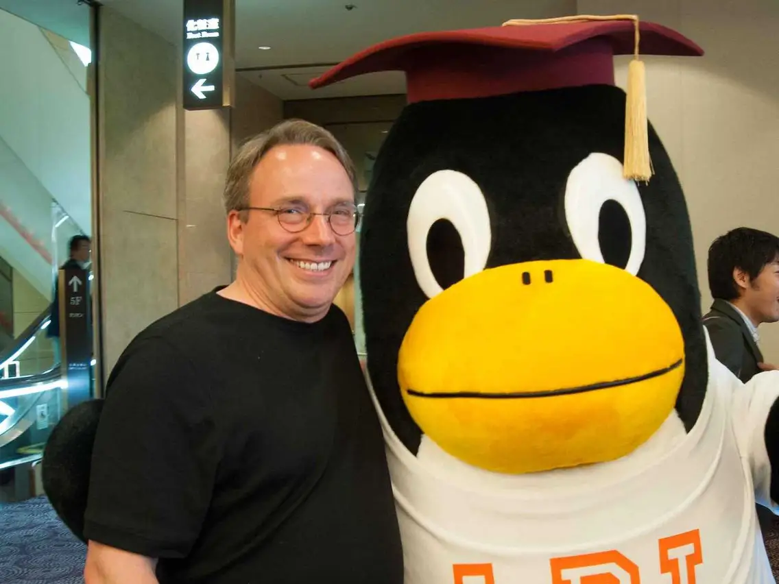
Linus Torvalds the Linux Inventor
Linux Distributions Timeline (wikimedia.org)

Slide 31
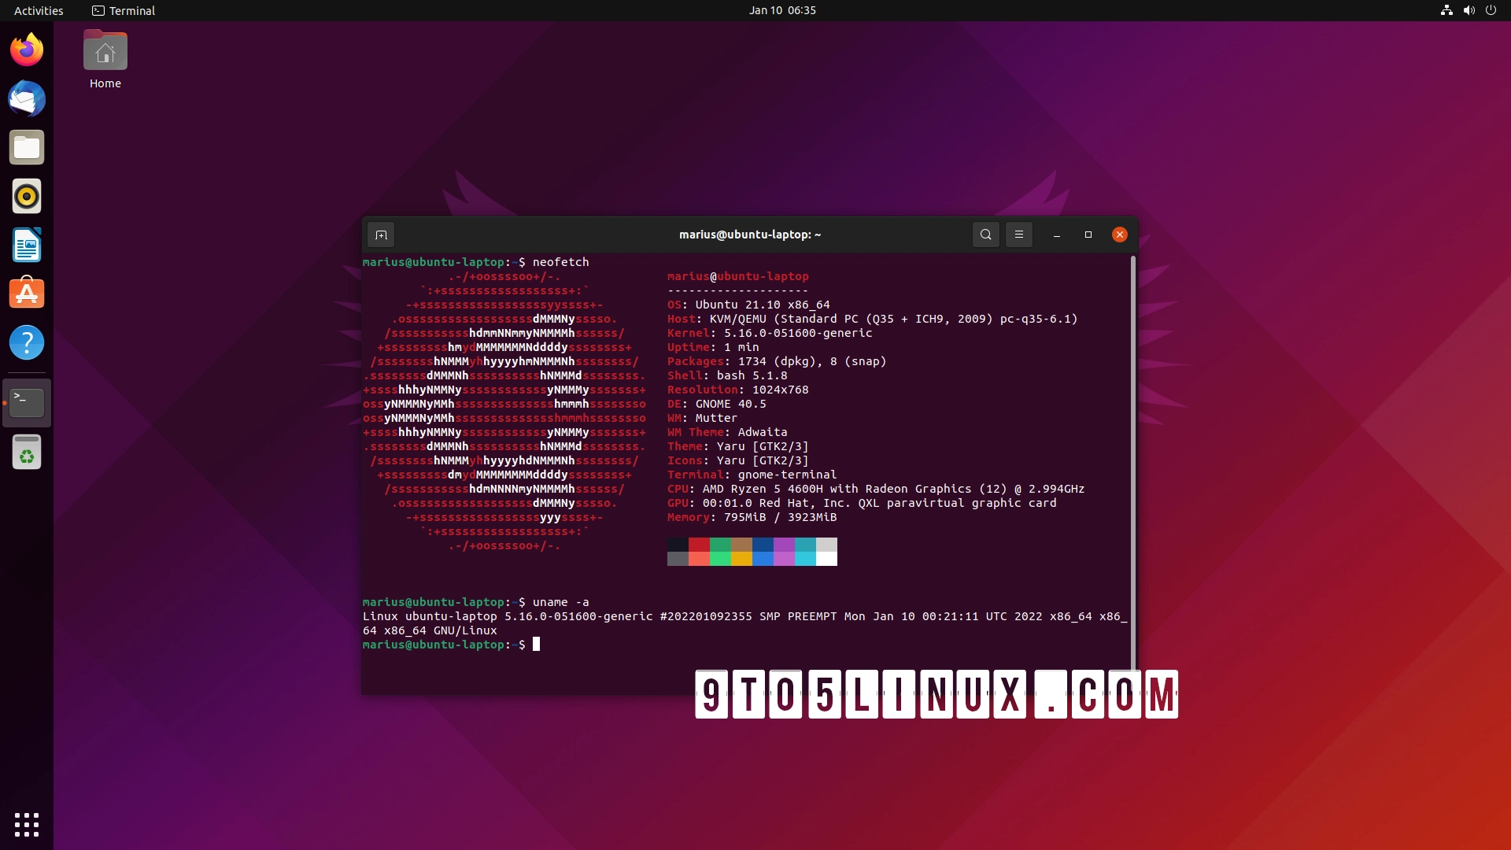
Linux : Ubuntu

Slide 32
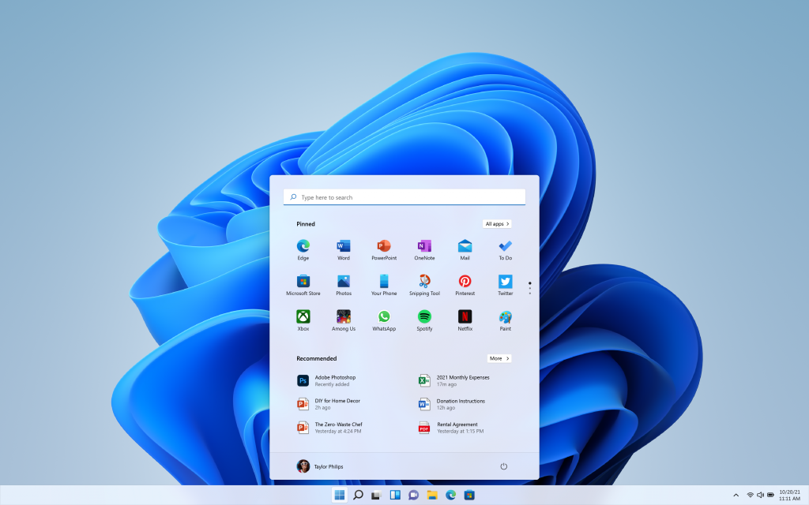
Windows 11

Slide 33
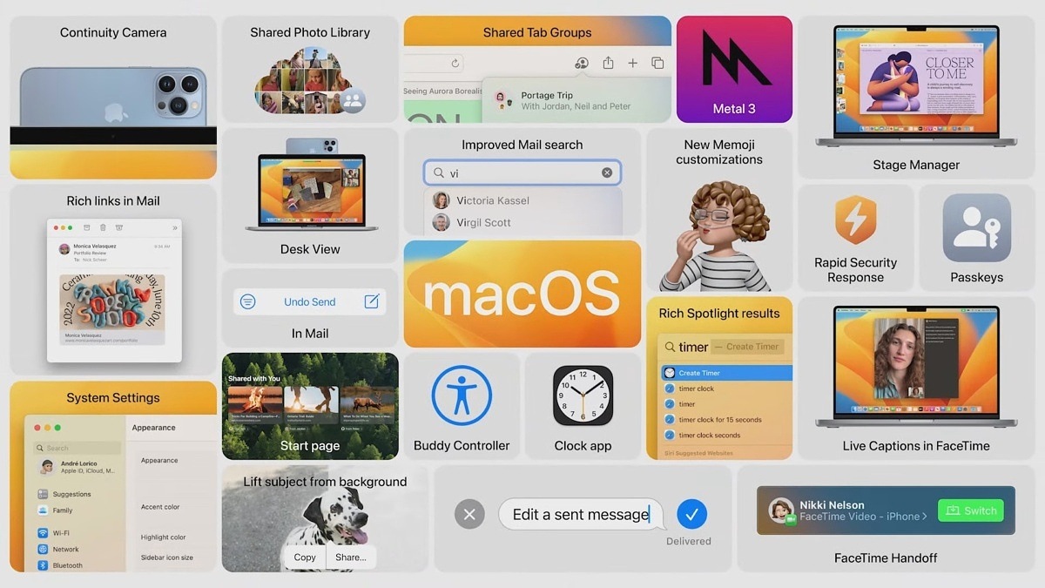
macOS Ventura

Slide 34
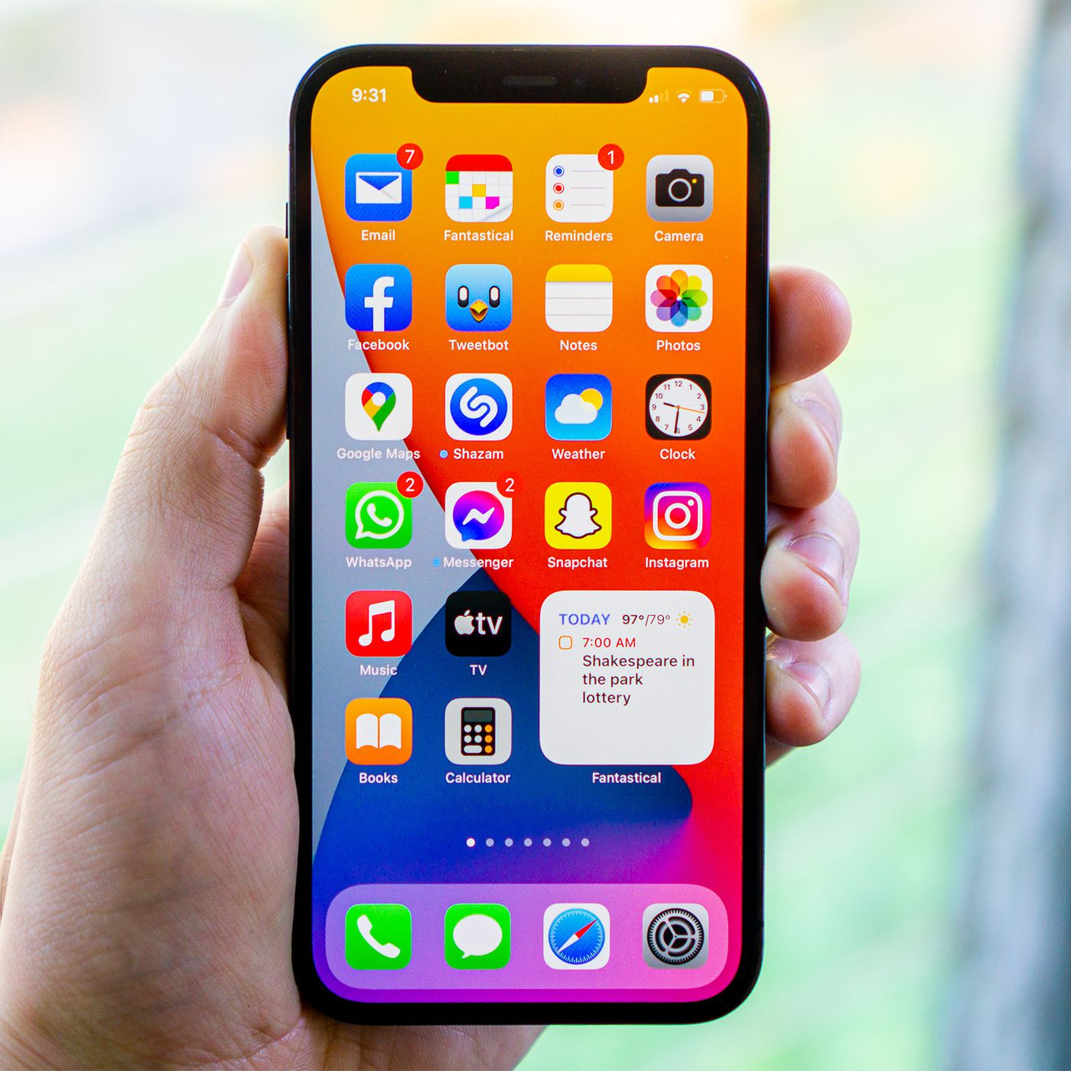
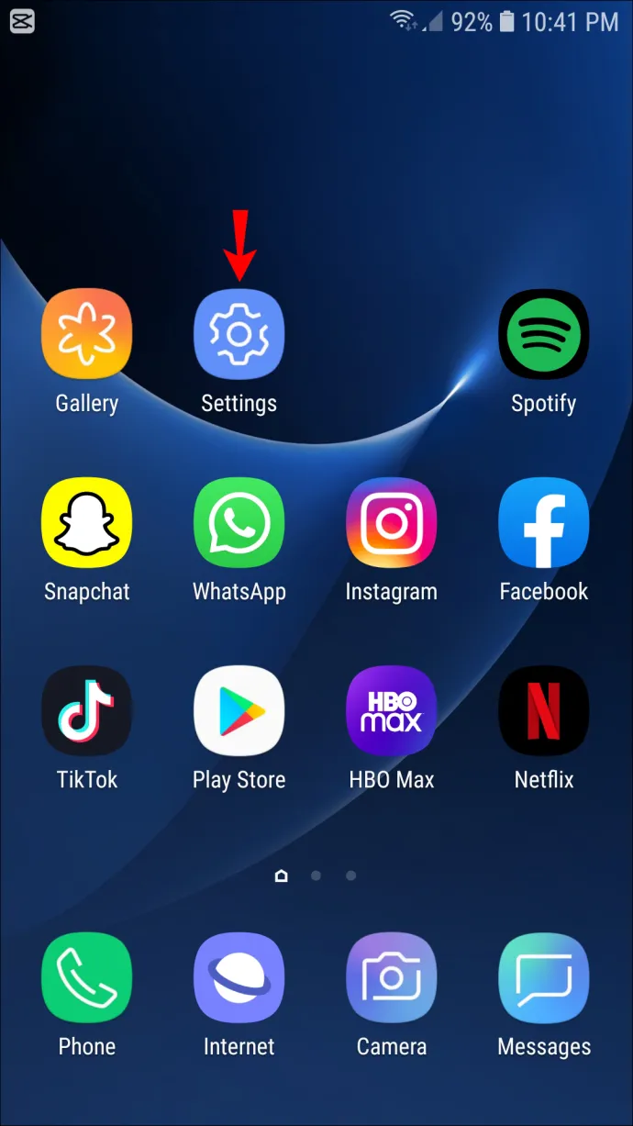
OS for mobile

Slide 35
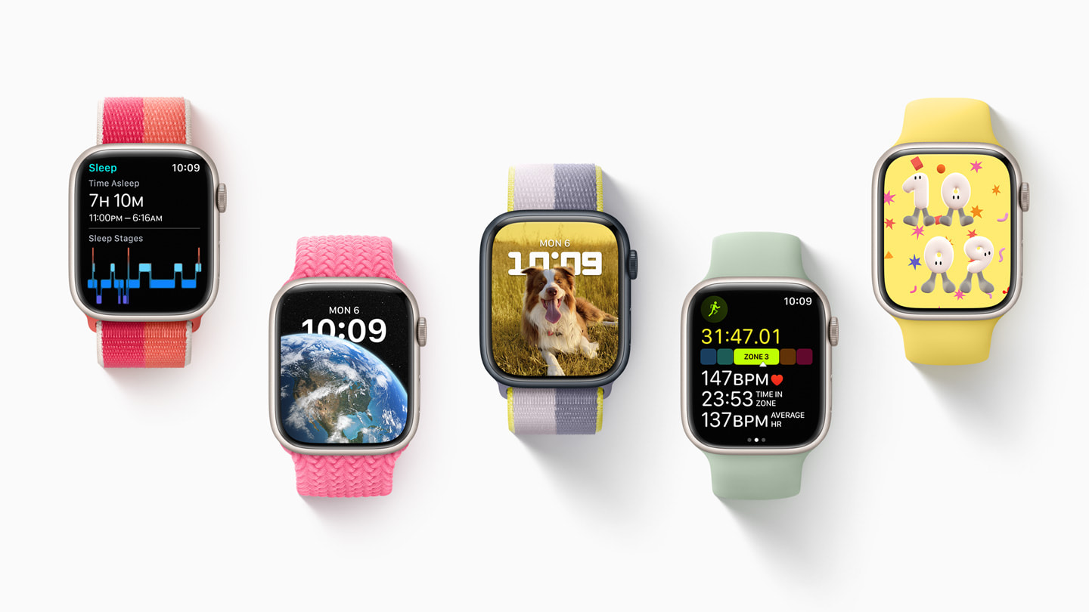
Apple watch os

Slide 36
WSL & install Ubuntu on Window 11
Install Ubuntu on WSL2 on Windows 10 | Ubuntu

Slide 37
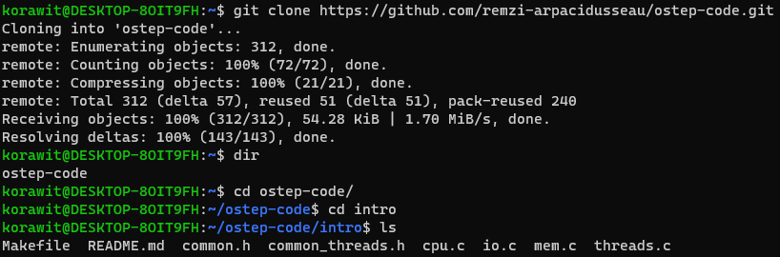
Lab notes: install git & git clone
Install Git | Atlassian Git Tutorial <<<---ลงตัวนี้ก่อนนะ
คลิกเพื่อเพิ่มข้อความ
คลิกเพื่อเพิ่มข้อความ

Slide 38
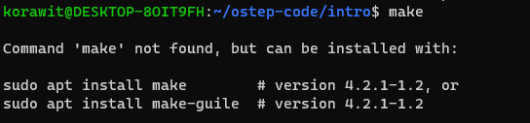
Install make (1)
ถ้าเรายังไม่ได้ลง make เวลารันแล้วจะไม่ได้ มันจะขึ้นข้อความด้านล่าง

Slide 39
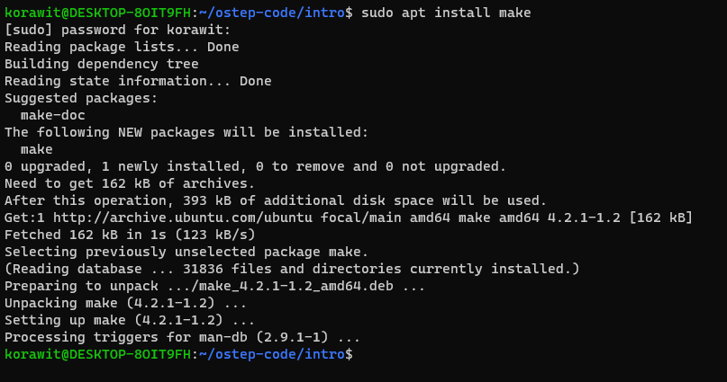
Install make (2)

Slide 40
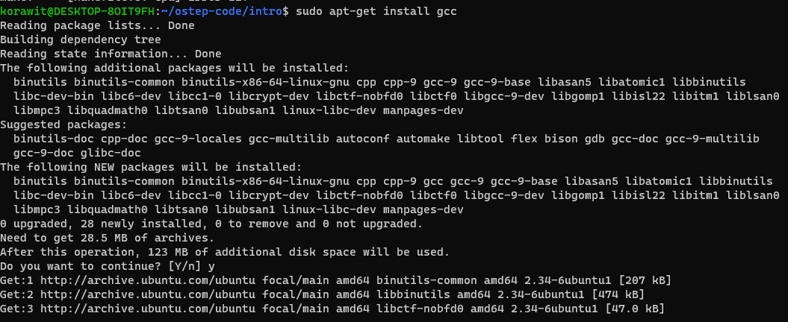
Install gcc

Slide 41
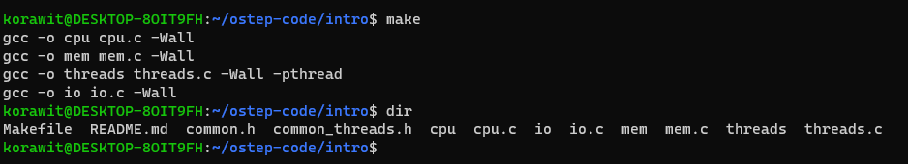
make

Slide 42
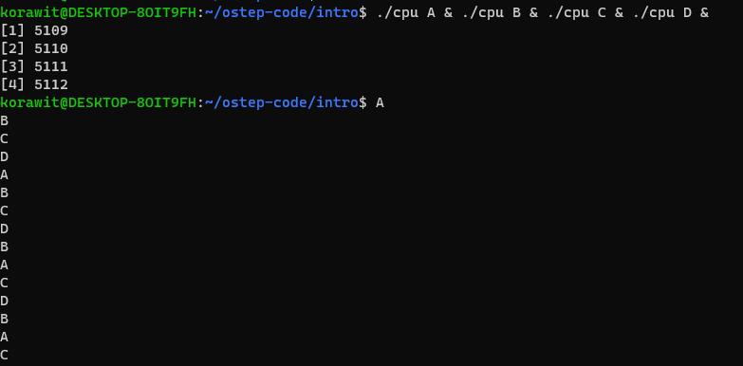
Run multiple cpu.c

Slide 43
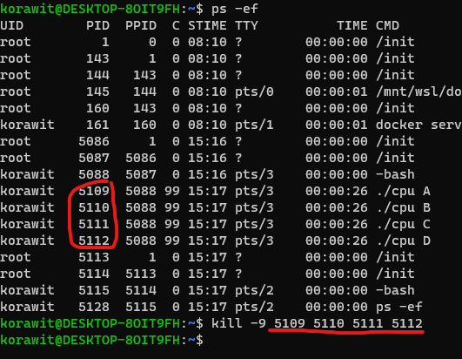
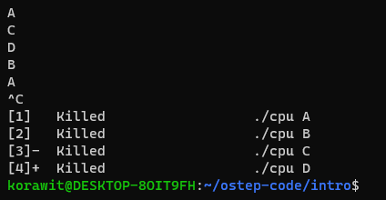
How to kill processes

Slide 44
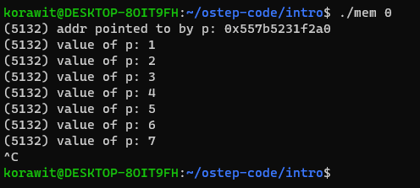
mem.c

Slide 45
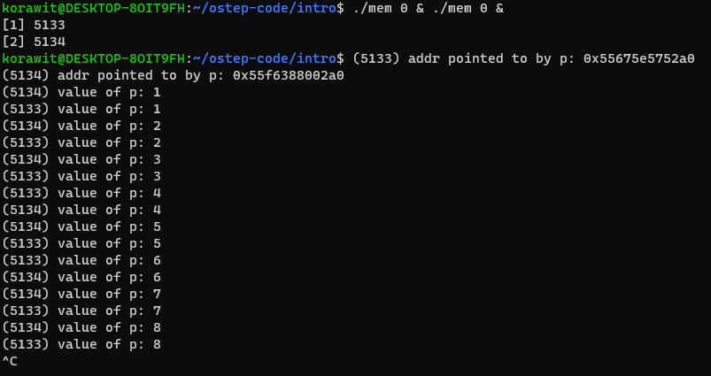
Run multiple mem.c
setarch $(uname --machine) --addr-no-randomize /bin/bash

Slide 46
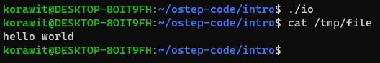
io.c

Slide 47
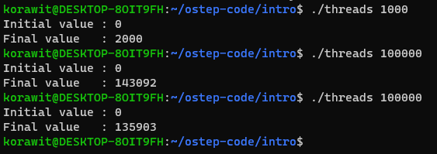
threads.c

